Slide 1
Post-award Grants Training
Susan Salem
Associate Director of Business Operations
Updated May 2017

Slide 2
THE grants office
Congrats!
Congratulations on your new grant!
Here are a few guidelines to help you through the post-award process.
Contacts
Susie Salem
Associate Director of Business Operations
Ext. 3863
Maggi Sutthoff
Interim Director of Grants & Strategic Initiatives
Ext. 4389

Slide 3
Table of contents
The Business Office
A New Account Number
The Budget Narrative
FMS Query
Expenditure Rules
Reporting Documents
The Invoicing Process
Federal Grants

Slide 4
Inform the business office
Paperwork
Please provide any paperwork and original documentation.
A description of the grant
Budget details
Invoicing information
Contact names at the granting agency.
Assign Responsibility
Designate someone to be the primary contact and grant manager. This person will be in charge of any reporting requirements.
Please provide their contact information to the Business Office.

Slide 5
Request a new account number
Official Request
Submit a request in writing (email) to the Business Office.
Susan.Salem@seattlecolleges.edu
Information Needed
Start and end dates
CFDA number (if applicable)
Contact at granting agency
Percentage of indirect
Grant description
Area grant is supporting
Budget Information
Verify in FMS Query
Once the Business Office confirms the new account number, please check FMS for accuracy.

Slide 6
Budget narrative
Share Budget Details
Provide the Business Office with a detailed narrative of the grant’s budget details.
Be specific and identify costs associated with all sub-objects.
FMS Query and Reporting
The information provided will be entered into FMS Query and will be used for reporting purposes.
Update
Please provide updated information anytime the budget changes.
The Business Office will prepare a budget revision.

Slide 7
Fms query
Access
Request FMS Query access from supervisor if necessary
Log On
Username and password is the same as Outlook
Training
Attend an FMS Query training session in The Learning Center at the earliest opportunity
OR
Contact the Business Office for a 1:1 training
Click FMS Query link to access the login page

Slide 8
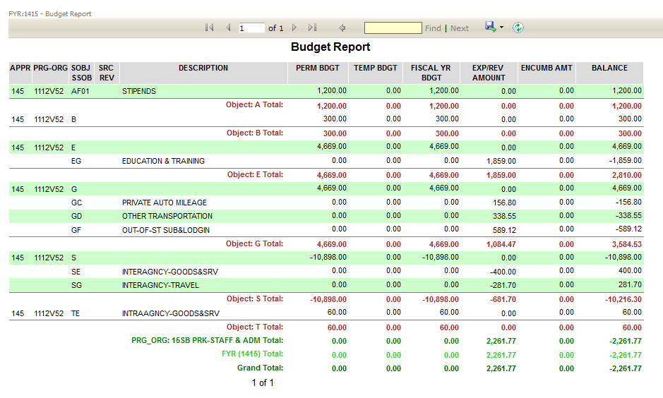
budget report in fms query

Slide 9
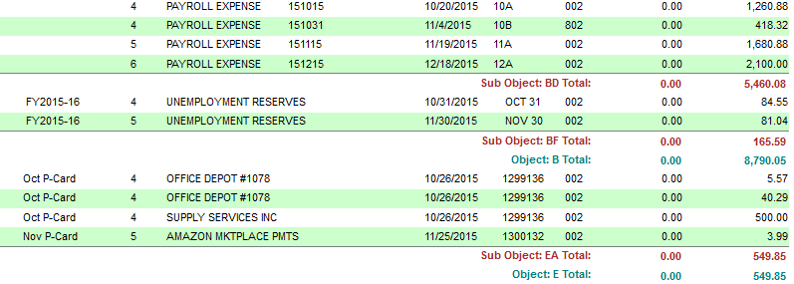
Expense report in fms query
Reconcile grant account monthly!
Are all expenses allowable?
Are salary and benefits expenses correct?
Did you spend in an area that you did not budget for?
Are you close to over-spending in any sub-object?
Is there anything that did not get charged to this account that should have been?
Were any IDCs processed?
Did we receive payment on any past invoices?
The Project Manager is responsible for the financial management of the grant, compliance and the project outcomes and results.
SCD Procedure 670

Slide 10
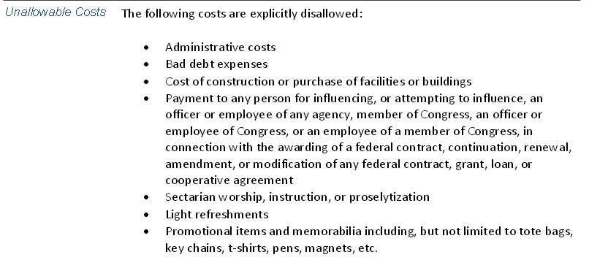
Allowable and unallowable expenses
Familiarize yourself with the guidelines of the grant and its allowable expenses. The chart below is an example of a grant with several unallowable costs. Please note – many grants do not allow the purchase of light refreshments.

Slide 11
Reporting documents
What Counts?
The PM1209 Report
Other useful reports include BA1211 (Salary & Wages), and PM1201 (Budget Status Report for Grants & Contracts)
Reporting documents are available on the 10th of each month
Public Folders
Reporting documents live in the Public Folders
Your supervisor must grant permission to access Public Folders
Part-time or hourly employees cannot have access to Public Folders
FMS Query
FMS Query reports and print-outs do not count as official reporting documents
FMS Query is a useful tool in reconciling accounts and should compared against reporting documents

Slide 12
Invoicing process
Invoice Request
Creating an invoice request is the first step toward receiving payment from a granting agency
It is important to follow the invoicing schedule outlined in the contract
Reporting Documents
Attach PM1209 reports to show monthly expenses
Submit for Approval
Supervisor approves the invoice request
Business Office signs the invoice request
Business Office
The Business Office will generate the actual invoice and send it to the granting agency

Slide 13
Federal grants
Time & Effort
Required by the Federal Government
Must account for 100% of time
Track time on TLR system or on paper
Common audit finding
Code of Federal Regulations
Uniform administrative requirements, cost principles and audit requirements for federal awards
Grants fall under CFR 200
Compliance Supplement
Helps auditors determine compliance requirements
Unique to each federal program
Performance
Reduce waste, fraud and abuse through better performance and accountability
Budget now tied to performance and deliverables
Follow proposal

