Slide 1

Global Solution – BPA Workshops
Foundation Proposal Review and Adoption
April 30, 2013
Tuesday
1

Slide 2

Agenda
Introductions and Welcome to PeopleSoft
Application List Overview
Foundation Decisions
Systems Overview and Integration Points
Useful Terminology

Slide 3
Applications List
Human Capital Management
Core Human Resources
  Includes Payroll
Performance Management
Succession Planning
Time & Labor
Benefits Administration
eCompensation
Absence Management
Recruiting Solutions
  Talent Acquisition Management
Campus Solutions
(Student Administration)
Recruiting and Admissions
  Campus Community
Student Records
  Academic Structure
  Academic Advisement
Financial Aid
Student Financials
Self-Service
Notes:
Item Types, Jerry’s slides

Slide 4
Applications List
Financials
Core Financials (GL, AP/PO)
Purchasing
eSupplier
eProcurement
Strategic Sourcing
Supplier Contracts
Asset Management
Project Costing
Contracts
Grants
Expenses
Treasury
eSettlements
Technology
Supporting Tools
Oracle Business Intelligence Application (OBIA)
Portal
Security
UPK

Slide 5
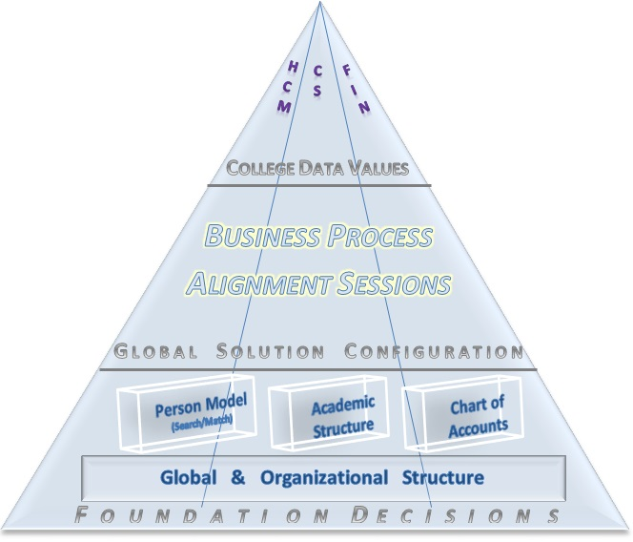
Foundation Decisions
Notes:
Foundation Decisions are decisions about key aspects of the ERP system configuration that are really the 'foundation' or first building blocks of the system. These first decisions set the format for such critical components as the Chart of Accounts, the Global Organizational Structure, the Academic Structure and the Person Model. If you think of building a house, these building blocks are what the rest of the system will rely on. If you think of the Chart of Accounts as the foundation building block, the structure is the "rebar" that runs through the modules (for example Student Financials) necessary for that module to function. So as we 'build out' our ERP system, the decisions we make in these sessions will guide the rest of the decisions in the Business Process Alignment sessions.

Slide 6
Foundation Decisions
Tests for solid foundation decisions:
  Can we access data?
    → Security
  Can we run a report?
    → Reporting
  Does the solution create any extra or out-of-the-ordinary processing overhead?
  What are the impacts on the integration points within each module?
  → Intra-integration
  What are the impacts on the integration points within each module??
  → Integration

Slide 7
Systems Overview and Integration Points
Human Capital Management (HCM)
Campus Solutions
(CS)
Financial Management (FSCM)
Human Capital Management provides functionality to support Human Resources business processes and replaces the existing PPMS, as well as providing additional functionality around recruitment and talent management. In addition, online Self-Service access for employees.
Campus Solutions provides functionality to support Student Administration business processes. This replaces the existing SMS, FAM and Degree Audit, as well as the WTS system with online Self-Service access for students and faculty.
Financial Management provides functionality to support Financial business processes and replaces the existing FMS, as well as providing significant additional functionality in Supply Chain Management (purchasing).
7
Notes:
PeopleSoft ERP Solution is divided into three "pillars":

Slide 8
Systems Overview and Integration Points
Human Capital Management (HCM)
Campus Solutions
(CS)
Financial Management (FSCM)
HR Core
Recruiting/Talent and Acquisitions Management
Payroll
Time and Attendance (Absence Management)
Benefits
Recruiting and Admissions
Student Records
Academic Advisement
Student Financials
Financial Aid
General Ledger
Accounts Payable
Accounts Receivable/Billing
Strategic Sourcing
Budgeting
Purchasing
Cash Mgmt./Expense/Treasury
Cashiering
Fixed Assets
Projects Grants/Capital Projects
Contracts
Grants
Supplier Contracts
Trust Funds
8
Notes:
Each of the 3 "pillars" contains a number of modules, such as the Student Financials module in CS, which replaces our current cashiering functionality for enabling student payment of tuition and fees.

Slide 9
Systems Overview and Integration Points
Human Capital Management (HCM)
HR Core - Provides the foundation for your human resource management system
Recruiting/Talent and Acquisitions Management - A complete, integrated system that enables organizations to effectively manage workforce acquisition across all employment categories. Whether you have a few resumes to fill hard-to-find positions or you have plenty of resumes but top candidates are scarce, Talent Acquisition Manager is ideally suited to meet your needs in any type of hiring conditions. Streams of applicants can be screened, interviewed, and hired quickly and efficiently.
Payroll - Payroll for North America provides the tools to calculate earnings, taxes, and deductions efficiently; maintain balances; and report payroll data while minimizing the burden on IT managers and payroll staff.
9
Notes:
Human Capital Management (HCM), which provides functionality to support Human Resources business processes and replaces our existing PPMS, as well as providing additional functionality around recruitment and talent management. In addition, online employee self-service will be provided.

Slide 10
Systems Overview and Integration Points
Human Capital Management (HCM)
Time and Attendance (Absence Management) –
  Absence Management enables organizations to automate the processes for planning and compensating paid time off for their workforce. It combines employee and manager capabilities and tracks all absences in a single application.
  Time and Labor facilitates the management, planning, reporting, and approving of time, and calendar and schedule creation and usage, from one global web-based application.
Benefits - When you implement PeopleSoft Benefits Administration, your first area of focus will be your benefit information. Using PeopleSoft terminology, benefit information includes programs, plan types, plans, rates, and calculation rules. All of this information is defined within the Manage Base Benefits business process in PeopleSoft Human Resources (HR).
10
Notes:
Human Capital Management (HCM), which provides functionality to support Human Resources business processes and replaces our existing PPMS, as well as providing additional functionality around recruitment and talent management. In addition, online employee self-service will be provided.

Slide 11
Systems Overview and Integration Points
Campus Solution (CS)
Recruiting and Admissions - Enables the institution to plan, manage and track its admissions and recruiting activities. Provides the capability to tailor the admissions process according to the requirements and practices of the institution. It also enables you to set enrollment targets , track progress toward recruiting efforts, and analyze admissions decisions and patterns.
Student Records - Enter, track, and process student academic and institution curriculum information; activate, enroll, grade, evaluate, and graduate students; create and maintain the course catalog and schedule of classes.
Academic Advisement - Provides the campus wide ability to define and track graduation requirements, configure Advisement reports, evaluate student degree progress, configure reports based on student degree progress, and convey requirements, policies, and procedures by analyzing the configuration of advisement rules and the student record.
11
Notes:
Human Capital Management (HCM), which provides functionality to support Human Resources business processes and replaces our existing PPMS, as well as providing additional functionality around recruitment and talent management. In addition, online employee self-service will be provided.

Slide 12
Systems Overview and Integration Points
Campus Solution (CS)
Student Financials - Enables the campus to manage and calculate student financial information. It provides functionality for billing and refunding student, as well as collecting past due balances. It provides functionality to set up payment plans for students. It also allows students to make payment online as well as through Cashiering.
Financial Aid - Support all awarding and disbursing functions. It will replace the existing FAM system and support all the regulatory release updates (4 Oracle Bundles each year). Financial Aid draws heavily on the other CS modules for data and coordination. There will also be an interface with HCM to support work-study students’ employment and earnings.
12
Notes:
Human Capital Management (HCM), which provides functionality to support Human Resources business processes and replaces our existing PPMS, as well as providing additional functionality around recruitment and talent management. In addition, online employee self-service will be provided.

Slide 13
Systems Overview and Integration Points
Financial Management (FSCM)
General Ledger
Accounts Payable
Accounts Receivable/Billing
Strategic Sourcing
Budgeting
Purchasing
Cash Mgmt./Expense/Treasury
Cashiering
13
Notes:
PeopleSoft Asset Management; along with PeopleSoft Purchasing, PeopleSoft Payables is a key collection point for asset information that flows into PeopleSoft Asset Management. This flow of asset information from vouchers works hand-in-hand with the flow of information from receiving documents that is recorded in PeopleSoft Purchasing to ensure accurate and up-to-date records.
PeopleSoft Billing; PeopleSoft Payables to process interunit invoices.
PeopleSoft eSettlements; eSettlements leverages nearly 80 percent of its functionality from the PeopleSoft Payables and Purchasing business processes. ((Whether capturing an XML invoice or creating an invoice through PeopleSoft eSettlements, you run the PeopleSoft Payables Voucher Build Application Engine process (AP_VCHRBLD) to create invoices in PeopleSoft eSettlements.))
PeopleSoft Expenses; PeopleSoft Payables payment interface enables you to produce payments for PeopleSoft Expenses transactions.
PeopleSoft General Ledger; PeopleSoft Payables sends accounting entries to PeopleSoft General Ledger through the Journal Generator Application Engine process (FS_JGEN). (PeopleSoft Payables interfaces with PeopleSoft General Ledger for budget checking and commitment control.)
PeopleSoft Payroll; The practice of payroll deductions being paid through an accounts payable system is standard. PeopleSoft Payables enables you to accept third-party payments from PeopleSoft Payroll.
PeopleSoft Purchasing; Vouchers can be built from various sources in PeopleSoft Purchasing, including purchase order and receiver lines, evaluated receipt settlement (ERS) vouchers, return to vendor (RTV) transactions, and procurement card system vouchers. You can perform matching among vouchers, purchase orders, receivers, and inspection status to improve control and accuracy. The system can automatically create debit memos to handle discrepancies between vouchers, purchase orders, and receivers. You view related documents across the entire procure-to-pay process. Using PeopleSoft Payables integration with PeopleSoft Purchasing, you can process vendor rebates using the rebate calculation functionality, which also integrates with PeopleSoft Receivables.
PeopleSoft Receivables; the refund process in PeopleSoft Receivables adds rows to tables that are used by PeopleSoft Payables to build a voucher.
PeopleSoft Student Administration; PeopleSoft Payables generates refund tuition checks for PeopleSoft Student Administration.

Slide 14
Systems Overview and Integration Points
Financial Management (FSCM)
Fixed Assets
Projects Grants/Capital Projects
Contracts
Grants
Supplier Contracts
Trust Funds
14
Notes:
PeopleSoft eSettlements; eSettlements leverages nearly 80 percent of its functionality from the PeopleSoft Payables and Purchasing business processes. ((Whether capturing an XML invoice or creating an invoice through PeopleSoft eSettlements, you run the PeopleSoft Payables Voucher Build Application Engine process (AP_VCHRBLD) to create invoices in PeopleSoft eSettlements.))
PeopleSoft Payroll; The practice of payroll deductions being paid through an accounts payable system is standard. PeopleSoft Payables enables you to accept third-party payments from PeopleSoft Payroll.
PeopleSoft Project Costing; When you enter voucher information in PeopleSoft Payables, you can also enter information that is picked up by PeopleSoft Project Costing. A project manager using PeopleSoft Project Costing can review costs to keep complete financial control of a project.
PeopleSoft Purchasing; Vouchers can be built from various sources in PeopleSoft Purchasing, including purchase order and receiver lines, evaluated receipt settlement (ERS) vouchers, return to vendor (RTV) transactions, and procurement card system vouchers. You can perform matching among vouchers, purchase orders, receivers, and inspection status to improve control and accuracy. The system can automatically create debit memos to handle discrepancies between vouchers, purchase orders, and receivers. You view related documents across the entire procure-to-pay process. Using PeopleSoft Payables integration with PeopleSoft Purchasing, you can process vendor rebates using the rebate calculation functionality, which also integrates with PeopleSoft Receivables.
PeopleSoft Student Administration; PeopleSoft Payables generates refund tuition checks for PeopleSoft Student Administration.
PeopleSoft Treasury Management; PeopleSoft Payables payment interface enables you to produce payments for PeopleSoft Treasury settlement transactions. And the integration with the PeopleSoft Financial Gateway feature enables you to submit electronic payments to a financial institution for settlement, without the need of a third-party integration tool.
PeopleSoft Payables also integrates with PeopleSoft Cash Management through the Treasury Netting Center. You must use PeopleSoft Cash Management with PeopleSoft Receivables to use the bilateral netting functionality that offsets open items with open vouchers in PeopleSoft Payables. This functionality is useful when you have customers that are also suppliers.

Slide 15
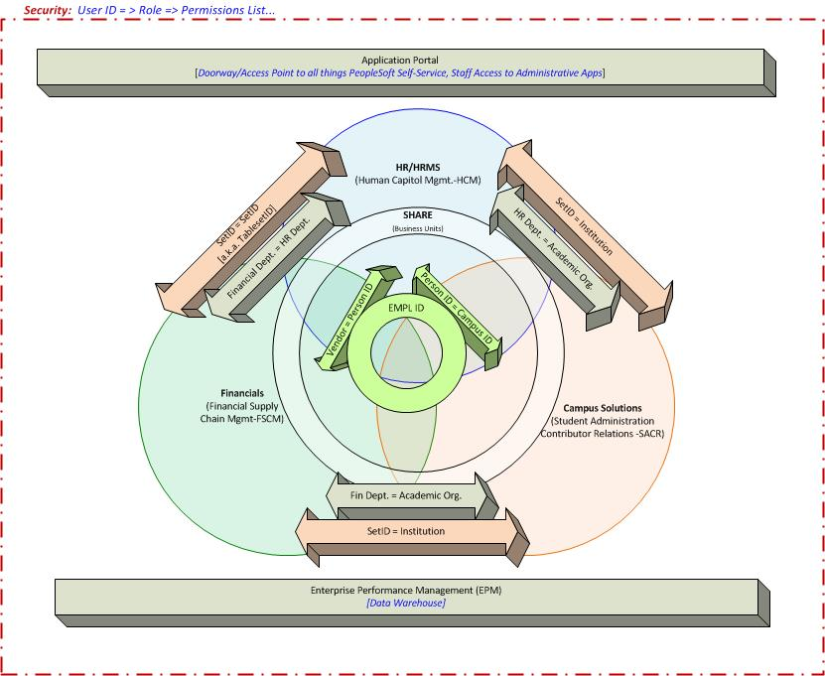
Systems Overview and Integration Points
Notes:
This is a graphical representation of Integration across the Pillars. 30 Districts, 35 Colleges, 34 Financial Aid Title IV Codes, 31 Legal Entities (IRS Reporting)

Slide 16
Human Capital Management
Company - Information about a single company or multiple companies in your organization, from the corporate address to general ledger accounts, tax information, and payroll processing information.
Business Unit - A business unit is an operational subset of an organization. Business units can be independent legal entities, or organizations that need to segregate their financial data for accounting purposes, or operational centers that segregate their operations for management purposes.
  Each Business Unit can have it’s own business rules
  There must be at least one Business Unit!
Department – Where the person is located, attached and accounted for. In the HCM Application , a Department is equivalent to a person.
Notes:
Business Unit Example: (Example: When different campuses of the same institution operate independently from each other financially)
The Student Financials business unit is the framework that controls all processing within the Student Financials application

Slide 17
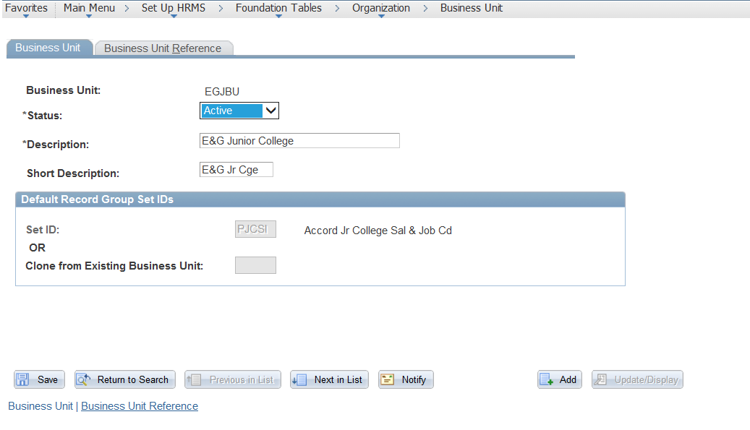
Human Capital Management
HR Business Unit
Notes:
A business unit is an operational subset of an organization. Business units can be independent legal entities, or organizations that need to segregate their financial data for accounting purposes, or operational centers that segregate their operations for management purposes.

Slide 18
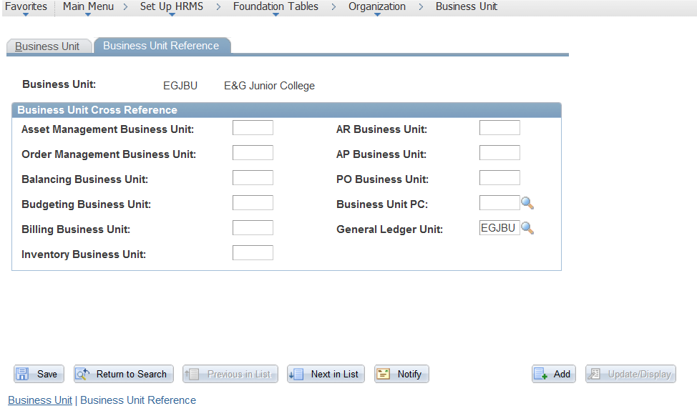
Human Capital Management
Integration: Business Unit configuration to connect to GL Business Unit

Slide 19
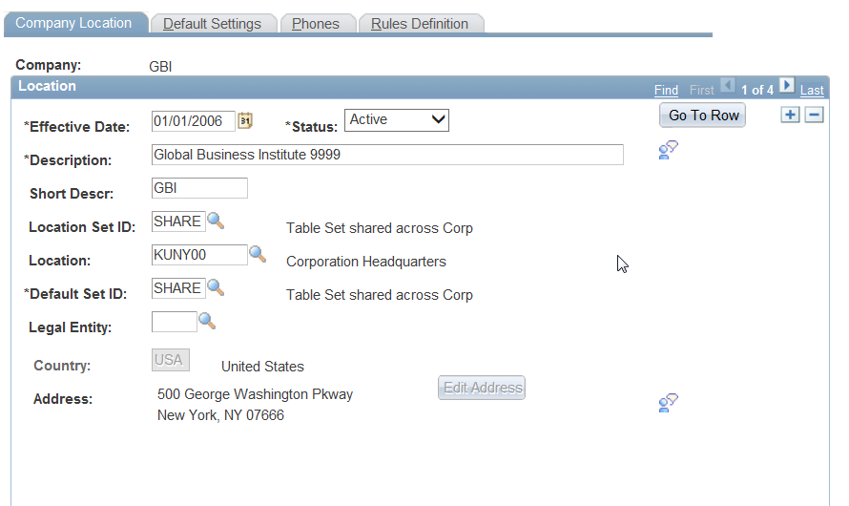
Human Capital Management
Following is an example of a HR Company:
Notes:
Company - Information about a single company or multiple companies in your organization, from the corporate address to general ledger accounts, tax information, and payroll processing information.

Slide 20
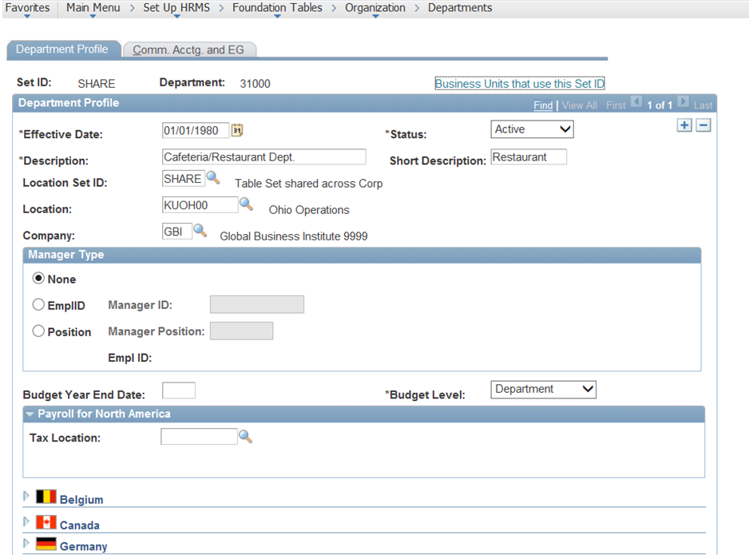
Human Capital Management
Following is an example of a HR Department:
Notes:
Department - Define business entities in your organization.

Slide 21
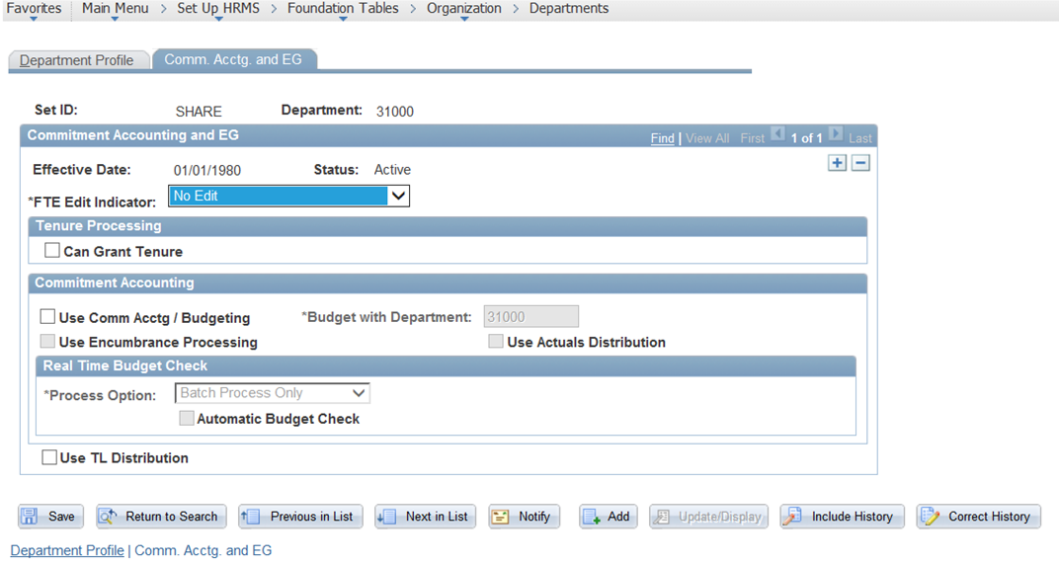
Human Capital Management
Integration: Department table configuration integration with Financial Management.

Slide 22
Human Capital Management
Key Concepts:
  Company
  Business Unit
  Department
Integration:
HCM Department ↔ CS Academic Organization
HCM Department ↔ FSCM Department
Integration Point with HCM:
∞ Faculty Workload ∞ EmplID

Slide 23
Campus Solutions
Academic Institution - An entity, such as a university or college, which runs independently from other like entities and has its own set of rules and business processes.
Academic Organization - Academic organization structure defines how an academic institution is organized from an administrative perspective.

Slide 24
Campus Solutions
Academic Institution
An entity, such as a university or college, which runs independently from other like entities and has its own set of rules and business processes.

Slide 25
Campus Solutions
Academic Institution
Each institution has its own schedule of classes, academic statistics, and academic transcript(s).

Slide 26
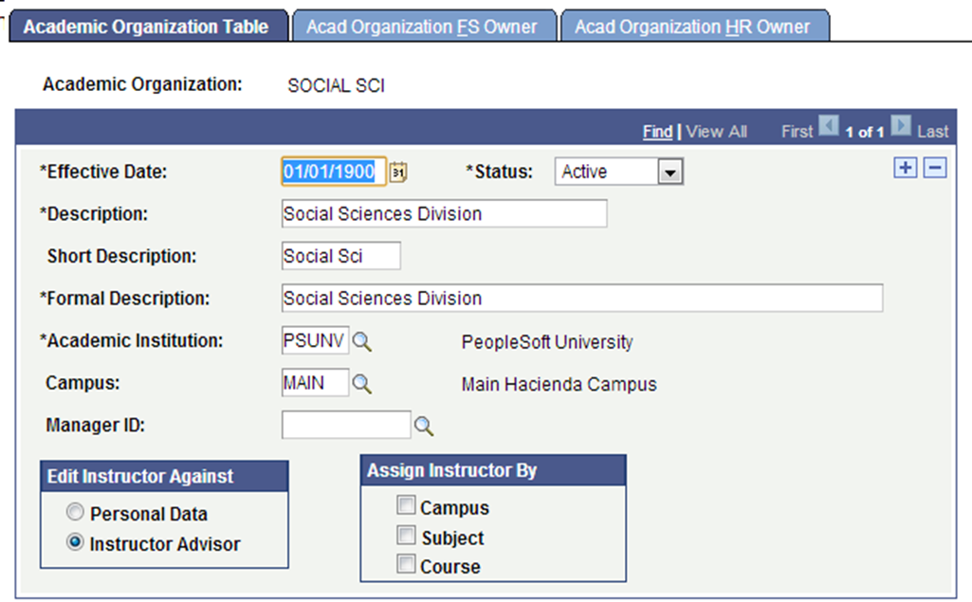
Campus Solutions
Academic Organization
Academic organization structure defines how an academic institution is organized from an administrative perspective.
The Academic Organization in the CS pillar links to both the HCM and Financials pillars.
Academic Organizations also assist with the security and reporting structures.

Slide 27
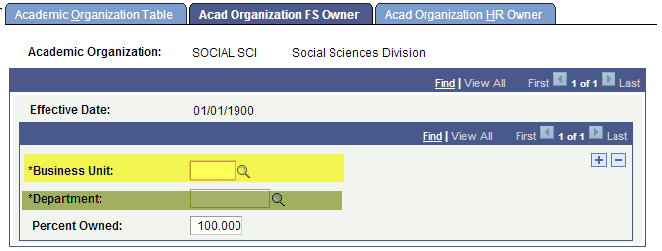
Campus Solutions
Academic Organization FS Owner (Financial Services Owner)
  Business Unit - the Financial Services Dept. responsible for this Academic Organization
    → Analysis, reporting, distribute revenue
  Department – department in which the Business Unit resides

Slide 28
Campus Solutions
Academic Organization FS Owner (Financial Services Owner)
  Business Unit - the Financial Services Dept. responsible for this Academic Organization
    → Analysis, reporting, distribute revenue
  Department – department in which the Business Unit resides

Slide 29
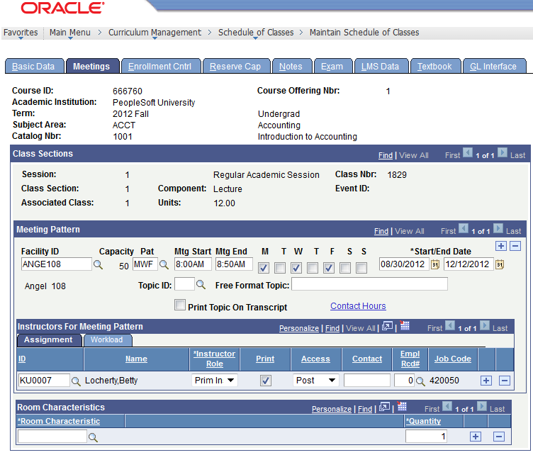
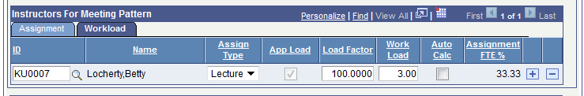
Campus Solutions
Faculty Workload
Assign and monitor the instructional and non-instructional workload for selected faculty, instructors, and staff; enables you to define workload limits for groups or individuals

Slide 30
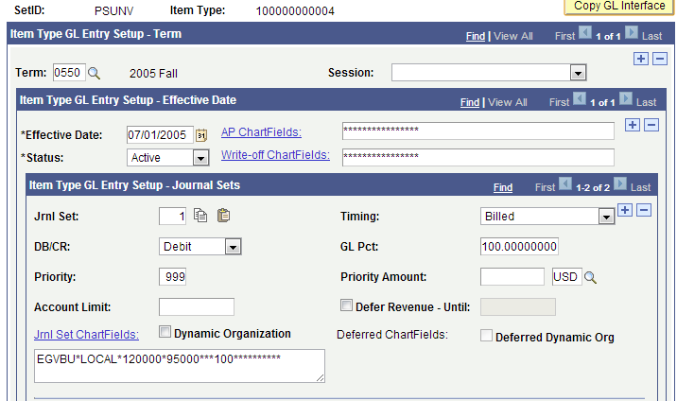
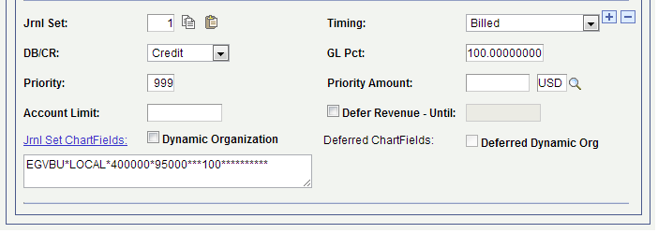
Campus Solutions
GL Interface:
Student Financial accounting information links to Financial Services through the General Ledger Interface process and the Cashiering Interface process
Every student financial transaction (charges, payments, refunds, waivers, financial aid, etc.) links to accounting information via an Item Type
The next slide shows debit and credit chartfield information on an Item Type

Slide 31
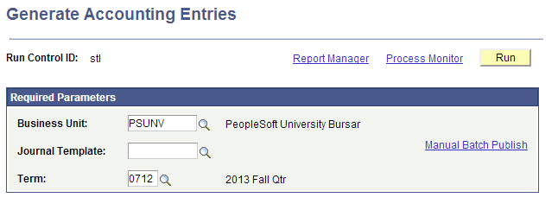
Campus Solutions
Student Financials GL Interface:
The General Ledger Interface process extracts the Student Financials transaction data at the debit and credit level, and sends it to Financial Services
This process is commonly scheduled to run automatically once per day

Slide 32
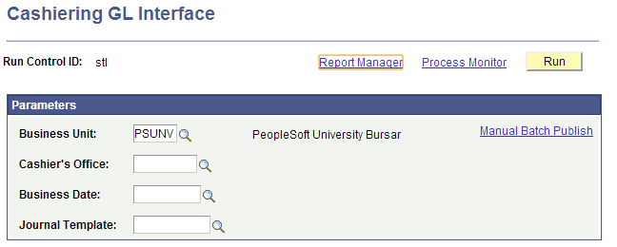
Campus Solutions
Cashiering GL Interface
The Cashiering GL Interface process runs separately from the main GL Interface. Its primary function is to send cashiering overages/shortages to the GL after the cash drawer has been counted

Slide 33
Campus Solutions
Key Concepts:
  Academic Institution
  Academic Organization/Business Unit
Integration:
CS Academic Organization ↔ HCM Department
CS Academic Organization ↔ FM Department
Integration Point with HCM:
∞ Faculty Workload ∞ EmplID
Integration Point with FSCM:
∞ GL Interface ∞ Cashiering ∞ AP Refunds

Slide 34
Financial Management
GL - HCM Integrations
From GL to HCM
From HCM to GL
  Ledger Definitions
  Calendars
  Journal Templates
  Chartfields
  Combination Edits
  SpeedTypes
  Payroll Expense Transactions
  Payroll Encumbrances
  Payroll Encumbrance Reversals
34

Slide 35
Financial Management
GL - Campus Integrations
From GL to Campus
From Campus to GL
  Ledger Definitions
  Calendars
  Journal Templates
  Chartfields
  Combination Edits
  SpeedTypes
  Student Financials Transactions
  Cashier Transactions
35

Slide 36
Financial Management
GL – Budgeting Integrations
GL to Hyperion Budgeting
Hyperion Budgeting to GL
  Budget Definitions
  Calendars
  Chartfields
  GL Journal Transactions
  Historical Leger Balances
  Operating Budgets
  Operating Budget Adjustments
36

Slide 37
Financial Management
Key Concepts:
  Business Unit
  Departments
Integration:
FSCM Department ↔ CS Academic Organization
FSCM Department ↔ HCM Department
Integration Point with CS:
∞ GL Interface ∞ Cashiering ∞ AP Refunds

Slide 38
Systems Overview and Integration Points
Notes:
30 Districts, 35 Colleges, 34 Financial Aid Title IV Codes, 31 Legal Entities (IRS Reporting)

Slide 39
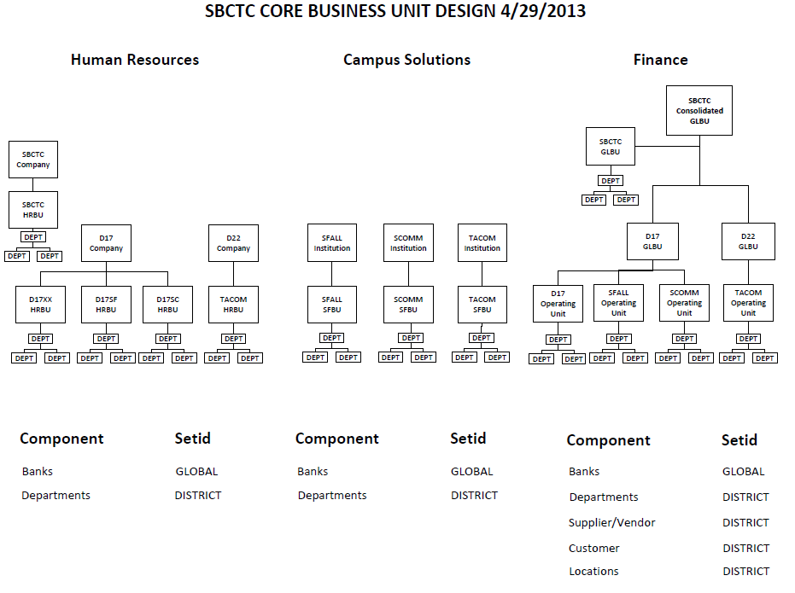
Systems Overview and Integration Points
Notes:
Draft Representation of Global Business Unit design across all Pillars as of 3/28/2013

Slide 40

Useful Terminology
Company - Information about a single company or multiple companies in your organization, from the corporate address to general ledger accounts, tax information, and payroll processing information.
Business Unit - An operational subset of an organization. Business units can be independent legal entities, or organizations that need to segregate their financial data for accounting purposes, or operational centers that segregate their operations for management purposes.
Departments - Where the person is located, attached and accounted for. In the HCM Application , a Department is equivalent to a person.

Slide 41
Useful Terminology
Academic Institution - An entity, such as a university or college, which runs independently from other like entities and has its own set of rules and business processes.
Academic Organization - The structure that defines how an academic institution is organized from an administrative perspective.
EmplID – “employee ID” – a catch all term for ID that still appears in some searches

Slide 42
Useful Terminology
Q&A Session
Wrap-Up
Next Day Agenda Items/Goals

Slide 43

Questions and Answers

