Slide 1
Budget 103:
FMS Query, IDCs and You
February 2019

Slide 2
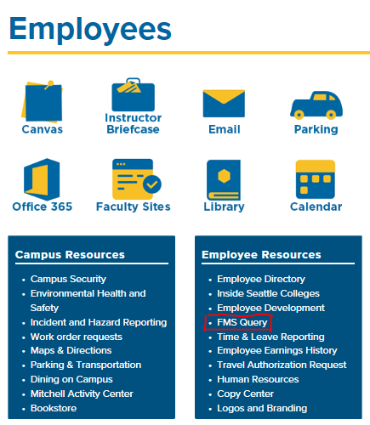
How do I log on to FMS Query?
Use the link on the Employee webpage or the Apps page
  https://seattlecentral.edu/employees
  https://apps.seattlecolleges.edu
Login using Outlook credentials
First.Last@seattlecolleges.edu
Password
Compatible with Internet Explorer and Chrome

Slide 3
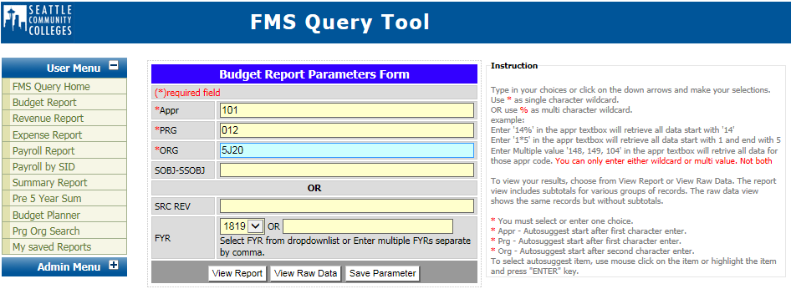
Budget Report – Enter your budget number
Budget Status Report
Summary report that combines budget plan with summarized data from accounting.

Slide 4
Budget Report Format/Formula – State Appropriation

Slide 5
Budget Report – Non-Operating Account

Slide 6
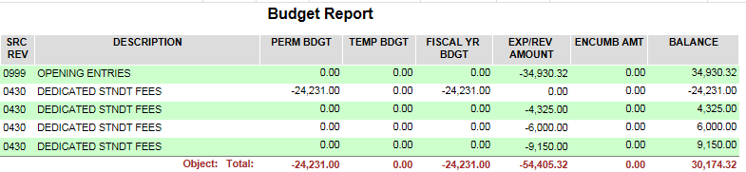
Why (-) and Why (+)
This is an accounting thing and differentiates between debits and credits
Debits are recorded as positives
  Increases in Expenses are recorded as Debits (+ value)
Credits are recorded as negatives
  Increases in Revenues are recorded as Credits (- value)

Slide 7
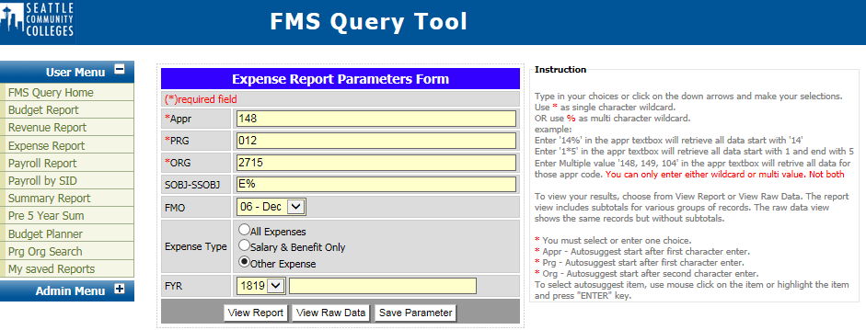
Expense Report – enter your budget number
Accounting Report
Revenue and expenditure reports that show individual transactions at the detail level.

Slide 8
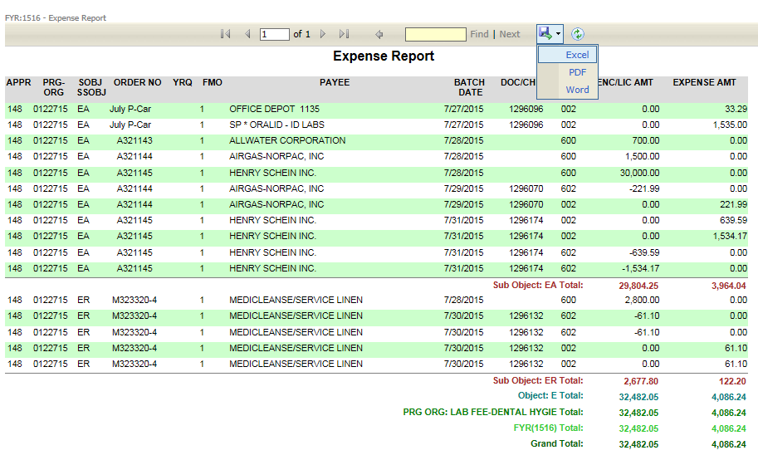
Expense Report
Appr-Prog-Org 5. Encumbrance
Sub-Object 6. Sub-Total and Total
Fiscal Month 7. Options to Open in Excel, PDF or Word
Transaction Code

Slide 9
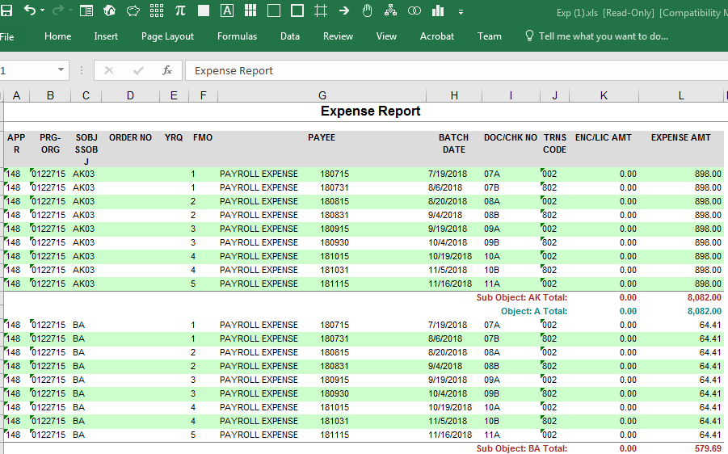
Download Expense Report to Excel

Slide 10

Expense Report - Look for the Details
Different appropriations Order No Doc/Chk No Negative Expense
  101, 3E0, 846 8462712OPG CBOSS194 What does that mean?

Slide 11
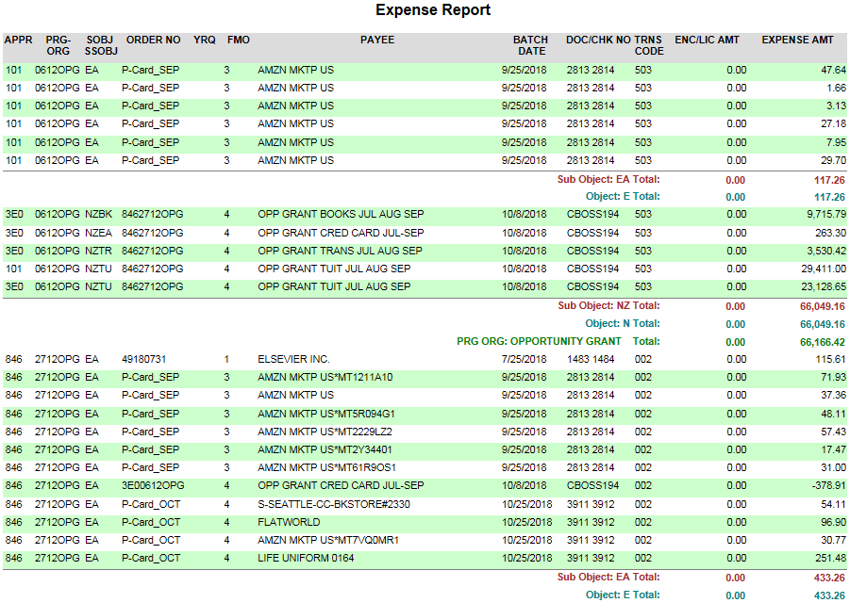
Look for the Details, Continued

Slide 12
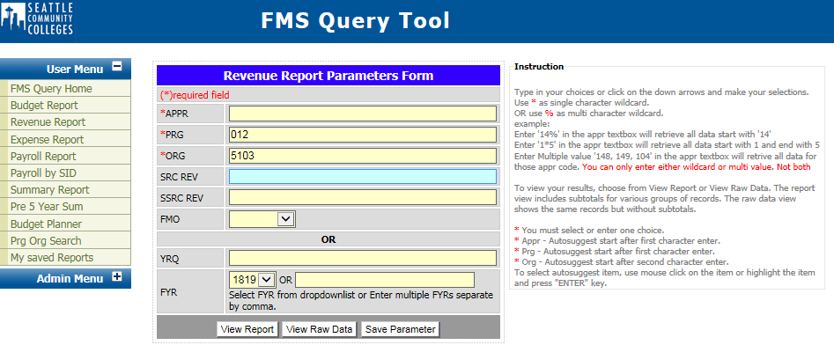
Revenue Report – enter your budget number
1. Source Revenue 4. Year/Quarter
2. Sub-Source 5. Revenue on Non-Operating
3. Negative Numbers

Slide 13
Revenue Report, Continued

Slide 14
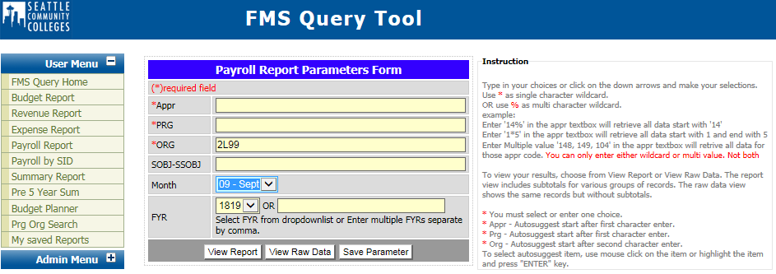
Payroll Report – enter your budget number

Slide 15
Payroll Report, Continued
Names
Check Date – this is September’s payroll
Gross Amount and Total Benefits
Health Insurance

Slide 16
Payroll on an Expense Report
Organized by object 4. Unemployment Reserves – 1% of A
No names 5. October Payroll – November dates
Health insurance

Slide 17
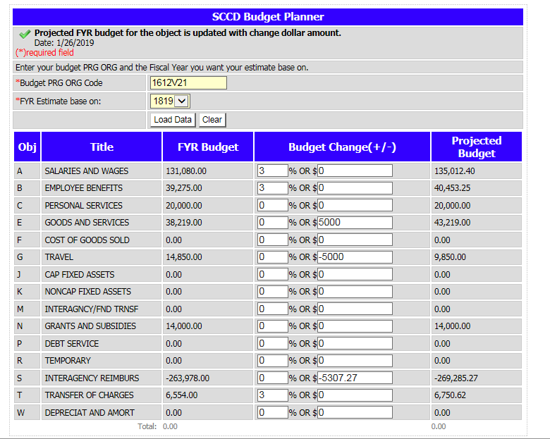
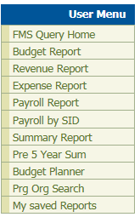
Budget Planner
Revenue = Expenses so $0 Projected Budget
I increased this grant budget by $5,300
Trying using your state budget

Slide 18
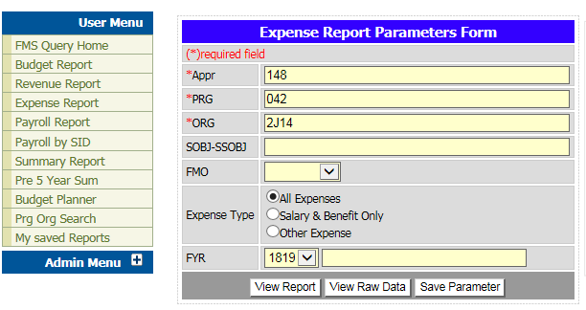
Use raw data to create a pivot table in Excel

Slide 19
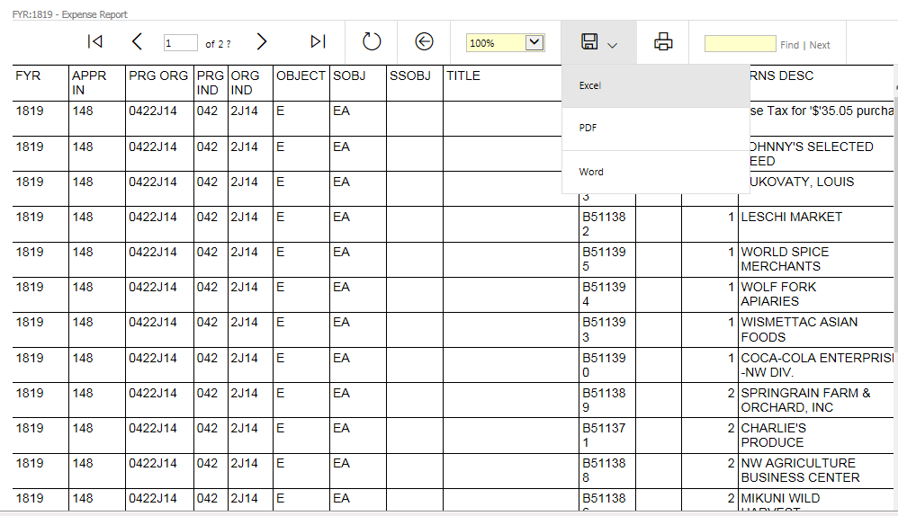
Accounting Report -> View Raw Data -> Download to Excel

Slide 20
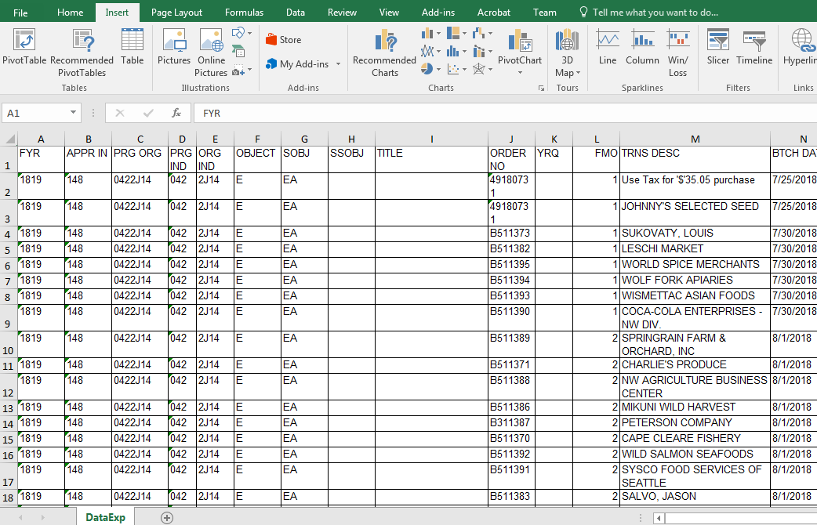
1. Insert Tab 2. Click on Pivot Table

Slide 21
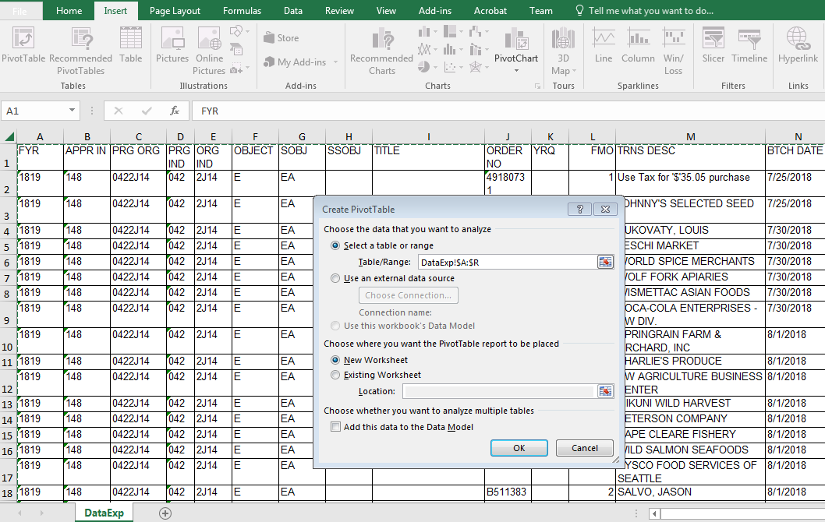
1. Select range of data you want in the pivot table 2. Choose location of pivot table

Slide 22
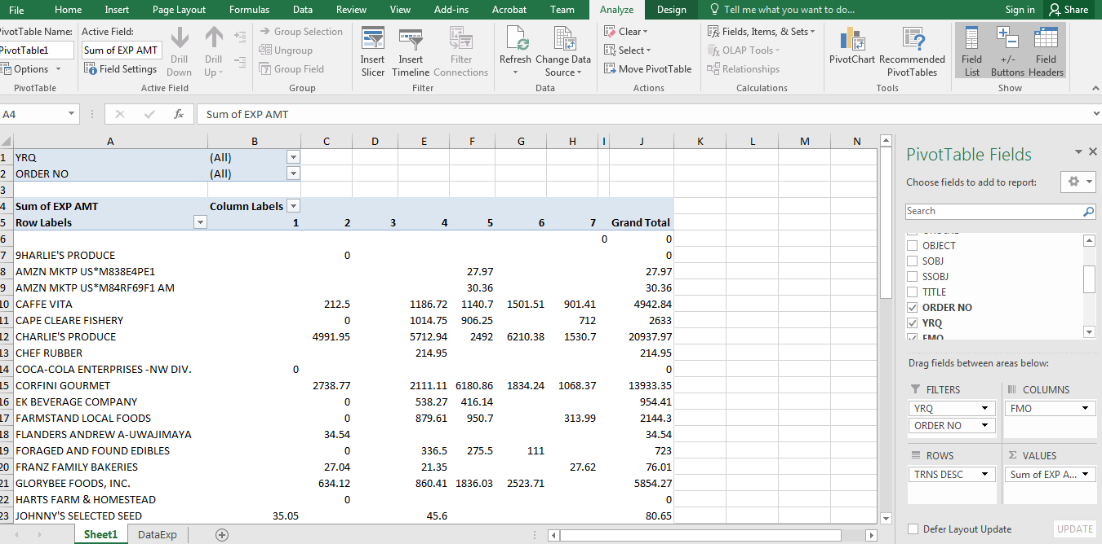

Slide 23
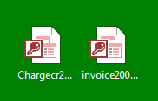
Interdepartmental Charge & Credit - IDC
Use this form to move expenditures between budgets, to correct revenues or charges to budgets, to charge another budget within Seattle Central for goods/services provided or transfer revenue within the same fund.
The IDC form must be filled out using Microsoft Access https://apps.seattlecolleges.edu/

Slide 24
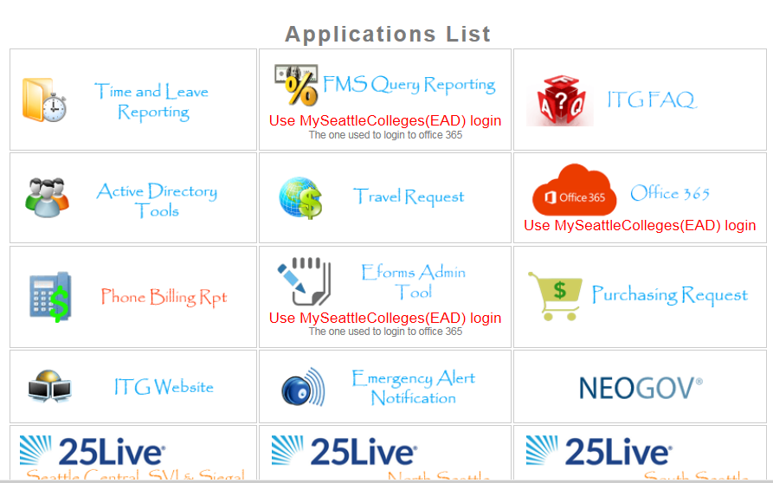

Slide 25
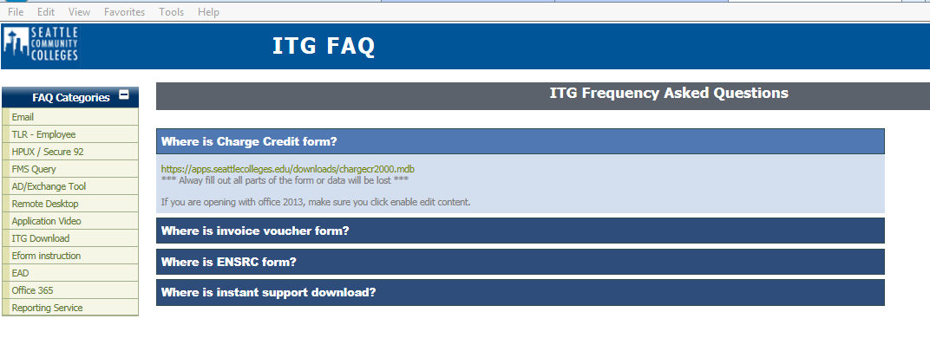
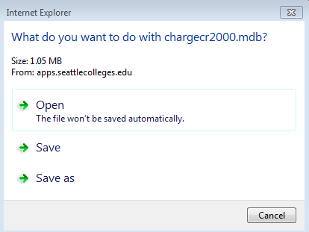
Click on ITG Download
Click on link under “Where is Charge Credit form?”
Save As and download to your desktop
Download 1 time only
Open from icon on your desktop from now on

Slide 26
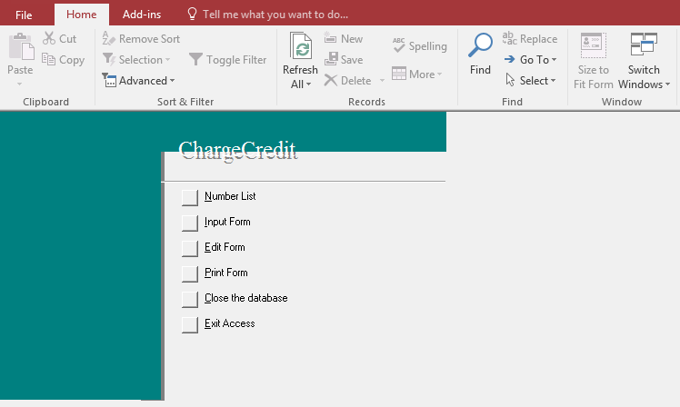
IDC Options
Number List – shows the number, title and amount of all IDCs you have created
Input Form – click here to begin a new IDC
Edit Form – allows you to edit an IDC you previously created
Print form – allows you to print an IDC you previously created
Exit Access – closes the application

Slide 27
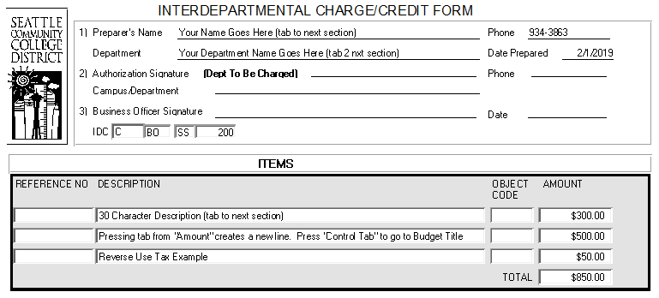
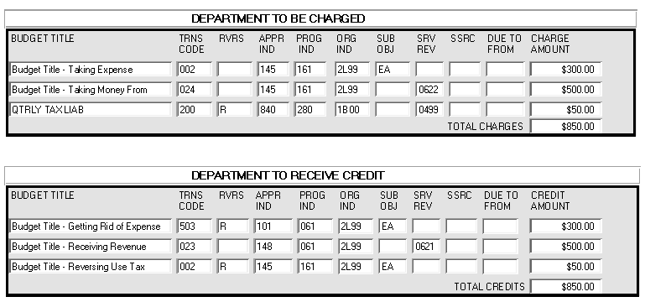
Fill in the lines available
You will not be able to click & write in Signature or Campus/Department lines
IDC Number
Choose campus from dropdown menu
Department initials – 2 or 3 letters
Your initials
Automatic number
Attachments
Attach an FMS Query accounting record and highlight the expense/revenue line you want to move
Attach additional documentation (emails, receipt to prove you already paid sales tax, etc.) that explain the IDC
Approvals
  The person responsible for the Department to be Charged must sign
  Send to the Business Office for signature

