Slide 1
Budget 102: FMS Query is Fun
December 2018

Slide 2
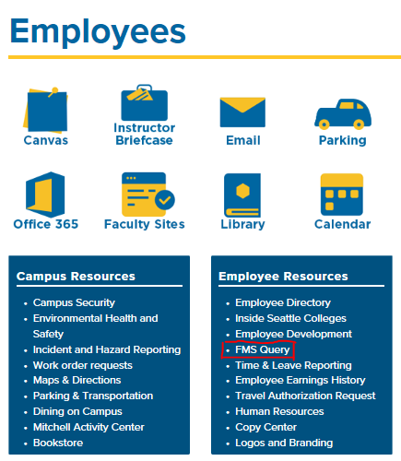
How do I log on to FMS Query?
Use the link on the Employee webpage or the Apps page
https://seattlecentral.edu/employees
https://apps.seattlecolleges.edu
Login using Outlook credentials
First.Last@seattlecolleges.edu
Password

Slide 3
Plan vs Reality
The Budget is your PLAN.
Accounting is REALITY.
The budget on FMS Query represents approval to spend money.
The Accounting Record displays the reality of what actually happened.

Slide 4
Two Types of Fiscal Reports
Budget Status Report
Summary reports that combines budget plan with summarized data from accounting.
Accounting Report
Detail revenue and expenditure reports that show individual transactions at the detail level.

Slide 5
Pre-Pop Quiz!
What is the name of the budget?
Is this a state account? How do you know?
What is the org index?
How much has been budgeted in salaries?
How much has been spent in benefits?
What is the sub-object in the “HOURLY” line?
Where is the encumbrance column and what does it do?

Slide 6
Pop Quiz Continued!
Is this an expense report or a revenue report?
Where can you find the fiscal month and which month is it?-
All of these transactions are coded as object ______ ?
Why does “Playground Sessions” have three transactions associated with it?

Slide 7
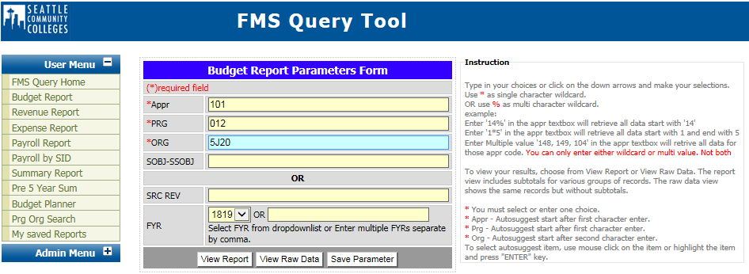
Budget Report

Slide 8
Budget Report – State Appropriation

Slide 9
Budget Report – Non-Operating Account

Slide 10
Why (-) and Why (+) ? This makes no sense.
This is an accounting thing and differentiates between debits and credits
Debits are recorded as positives
Increases in Expenses are recorded as Debits (+ value)
Credits are recorded as negatives
Increases in Revenues are recorded as Credits (- value)

Slide 11
Accounting Detail on the Budget Report

Slide 12
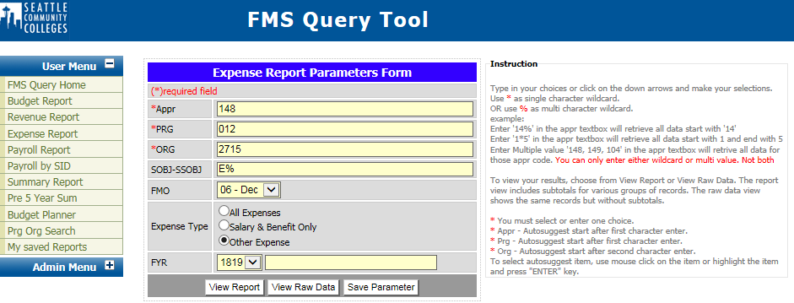
Expense Report

Slide 13
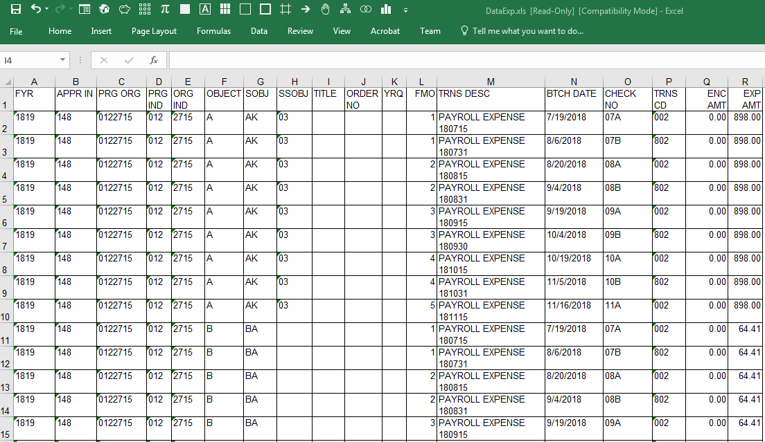
View Raw Data

Slide 14
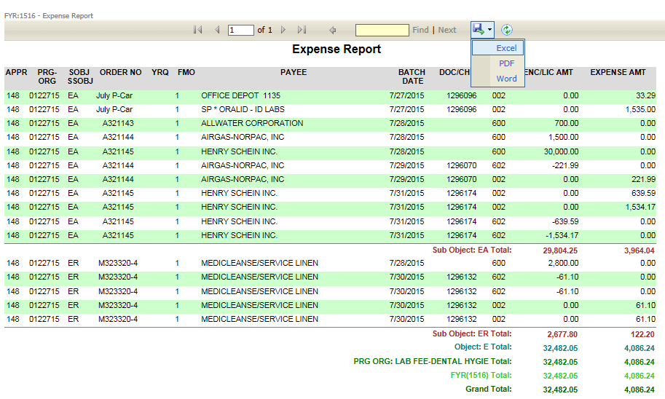
Expense Report
Appr-Prog-Org 5. Encumbrance
Sub-Object 6. Sub-Total and Total
Fiscal Month 7. Options to Open in Excel, PDF or Word
Transaction Code

Slide 15
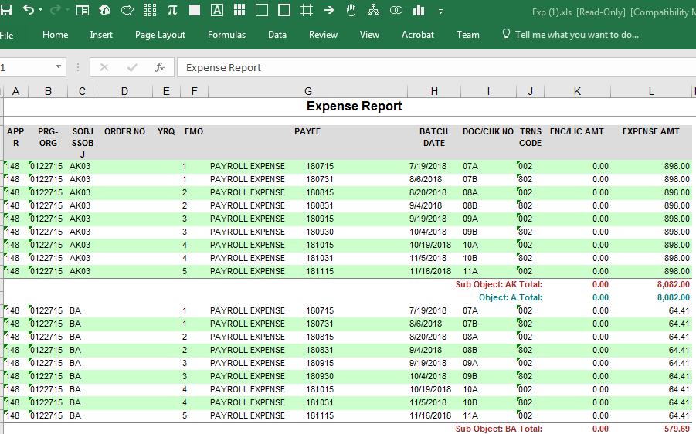
Download Excel from Expense Report

Slide 16
Expense Report - Look for the Details
Different appropriations Order No Doc/Chk No Negative Expense
101, 3E0, 846 8462712OPG CBOSS194 What does that mean?

Slide 17
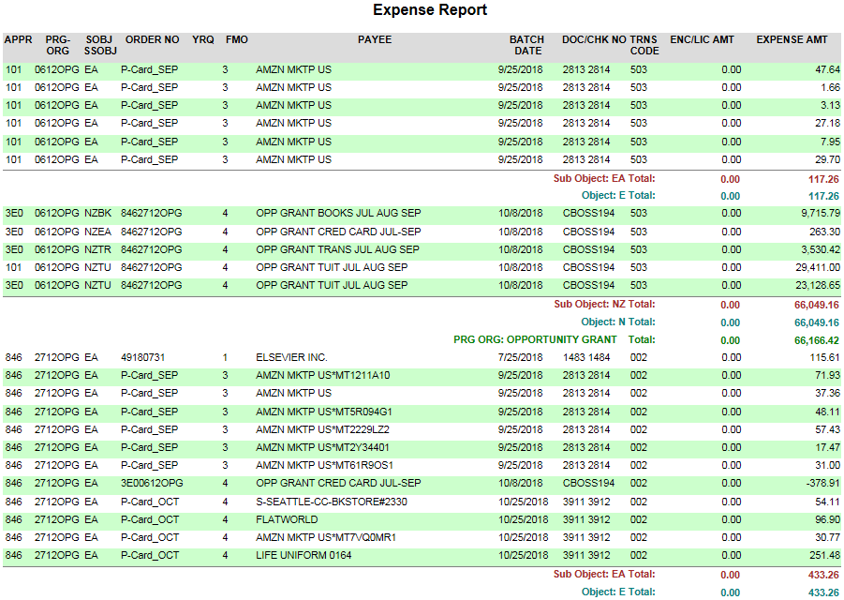
Look for the Details, Continued

Slide 18
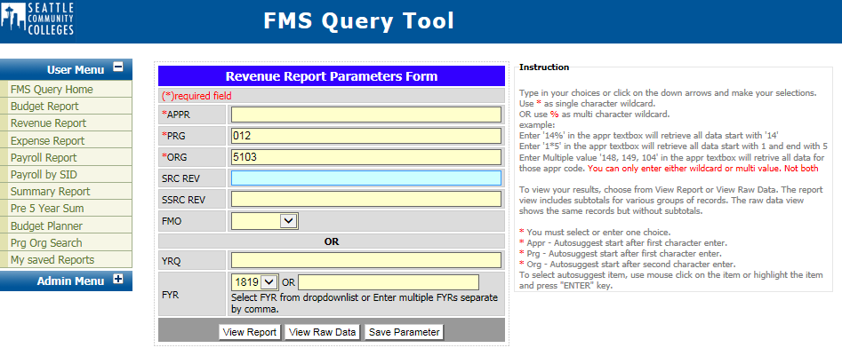
Revenue Report
1. Source Revenue 4. Year/Quarter
2. Sub-Source 5. Revenue on Non-Operating
3. Negative Numbers

Slide 19
Revenue Report, Continued

Slide 20
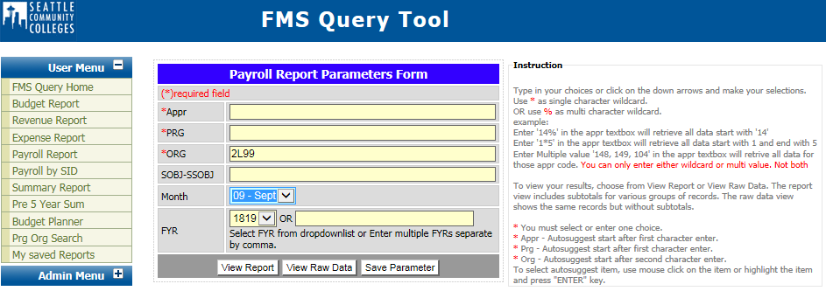
Payroll Report

Slide 21
Payroll Report, Continued
Names
Check Date – this is September’s payroll
Gross Amount and Total Benefits
Health Insurance

Slide 22
Payroll on an Expense Report
Organized by object 4. Unemployment Reserves – 1% of A
No names 5. October Payroll – November dates
Health insurance

Slide 23
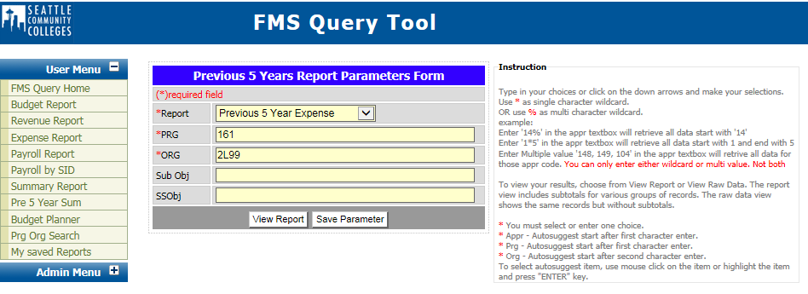
Previous 5 Year Summary
Perm Budget
FYR Budget
Temp Budget
Expense
Revenue

Slide 24
Previous 5 Year Summary

Slide 25
FMS Query Tips & Tricks
Payroll by SID is actually Payroll by SID.
You can have the same pro-org, but different appropriations.
Previous 5 Year Summary is an easy way to get a lot of information in one easy click.
Prg Org Search is the best! Type in words, not numbers. Example, Perkins.
Payroll Report – Pull data by month for accurate numbers.
View Raw Data will give you a basic Excel file. Downloading to Excel once you are in a report will give you all the colors but none of the formulas will translate.
Expense Report – All Expenses, Salary & Benefit Only, Other Expense. Or search by sub-object.
Play around with all the reports – you can’t change or hurt anything.

Slide 26
Post-Pop Quiz!
What is the name of the budget?
Is this a state account? How do you know?
What is the org index?
How much has been budgeted in salaries?
How much has been spent in benefits?
What is the sub-object in the “HOURLY” line?
Where is the encumbrance column and what does it do?

Slide 27
Pop Quiz Continued!
Is this an expense report or a revenue report?
Where can you find the fiscal month and which month is it?-
All of these transactions are coded as object ______ ?
Why does “Playground Sessions” have three transactions associated with it?

